Slide 1


Slide 2

APPROACHES to TEACHING
Chapter Three:
The Facilitator Approach
Part 3

Slide 3

Constructivism

Slide 4

Constructivism & multiple intelligences are two quite different notions about how we learn, but both are derived from the same school of psychology known as “cognitive psychology”.

Slide 5
Constructivism
Cognitive Psychology
Multiple intelligences
Both notions attend to how the mind processes experience, particularly how mental organization, memory, and learning are accomplished. we can draw some inferences about how to organize instruction.
These inferences permit us to acquire information in ways that are most closely aligned with how the mind processes information

Slide 6
What is constructivism?
Constructivism is ‘an approach to learning that holds that people actively construct or make their own knowledge and that reality is determined by the experiences of the learner’ (Elliott et al., 2000:256).
In elaborating constructivists’ ideas Arends (1998) states that constructivism believes in personal construction of meaning by the learner through experience, and that meaning is influenced by the interaction of prior knowledge and new events.

Slide 7

Constructivism says that children learn by constructing meaning for what they experience.
It means that learners do not simply accept which is presented to them. Instead, they try to make sense of it, often by connecting it to other information already present.
This process might alter the learner’s mental frameworks or might cause the student to change the new information to fit the framework already in place.
Jean Piaget referred to these processes as assimilation and accommodation.

Slide 8
What is the role of student?
Constructivism contends that children learn by constructing meaning for what they experience. They try to make sense of it, often by connecting it to other information or mental organizations already present.
What is the role of teacher?
The constructivist teacher attempts to assist students to acquire concepts and mental structures that accommodate subject matter in ways that are both valid and meaningful

Slide 9

The constructivist encourages students to use whatever experience, knowledge and mental frameworks they bring to school, while guiding them in the formulation of newer and more powerful concepts in order to assimilate and accommodate the subject matter of study.

Slide 10

The positive side of constructivism is that it attends carefully to the connections between the mental “maps” the students have when they enter the classroom and the knowledge the teacher seeks to present once they are there.
The downside of constructivism is that students may believe that they correctly understand new material when in fact they do not, and the teacher may conclude that their understanding is correct when it is not!

Slide 11

New information and experience must be presented in ways that facilitate the learner’s imparting meaning to it, generally by connecting it to understandings already held and building new frameworks to accommodate it.

Slide 12
Multiple Intelligences

Slide 13
Multiple Intelligences
Gardner argues that human beings have the ability to solve many different kinds of problems and make or create things that are valued in one or more cultural settings.
1.Linguistic intelligence (as possessed by a poet, for example
2.Logical-mathematical intelligence (as in a physicist or mathematician)
3.Spatial intelligence (sculptor or architect)
4.Musical intelligence (cellist or conductor)
5.Bodily-kinesthetic intelligence (dancer, athlete)
6.Interpersonal intelligence (sensitivity to others; for example, a teacher)
7.Intrapersonal intelligence (possessing a well-developed sense of self)

Slide 14

Intelligences | Examples or features
1.Linguistic | poet
2.Logical-mathematical | physicist, mathematician
3.Spatial | sculptor, architect
4.Musical | cellist, conductor
5.Bodily-kinesthetic | dancer, athlete
6.Interpersonal | teacher
7.Intrapersonal | well-developed sense of self
Howard Gardner in
his
1983 work argued for seven intellig-ences:

Slide 15
In a later work, Gardner suggests two additional forms: naturalist intelligence, which is the ability to recognize and categorize objects in nature; and existential intelligence, which is a capacity to grapple with the profound questions of human existence.
The idea that there are other intelligences worthy of cultivation in the setting of the school offers the teacher a strong rationale for supporting a broad range of choices as students pursue their interests and talents.

Slide 16

In
later work, Gardner suggests two additional forms:
1.Naturalist intelligence | The ability to recognize & categorize objects in nature
2.Existential intelligence | A capacity to grapple with the profound questions of human existence

Slide 17
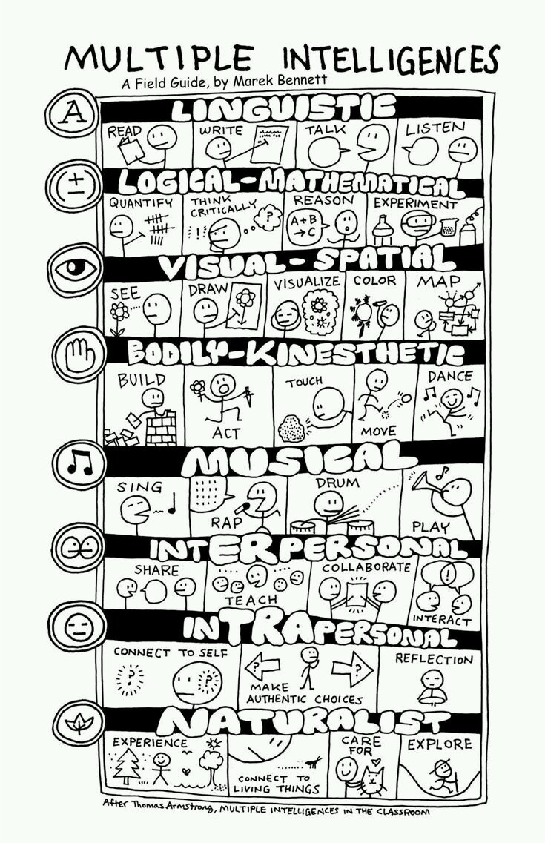


Slide 18
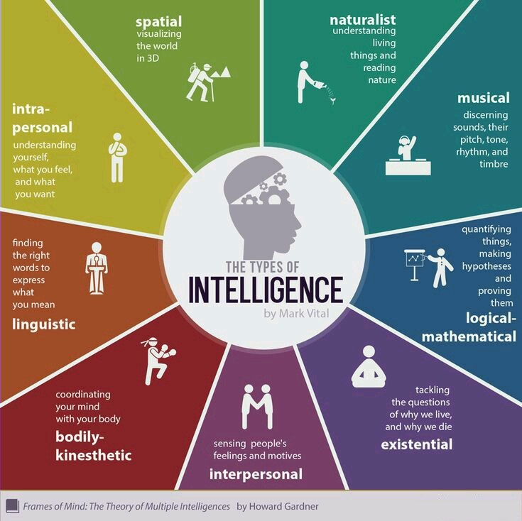

Slide 19

“If you go back to the (A) in maker, you will note that Gardner’s theory offers a facinating way to become more aware of one’s students.”

Slide 20

Another aspect of MI theory is that it supplies the facilitative teacher with educationally relevant reasons for respecting the choices that students make.
“Choice is a key feature of the facilitative setting.”

Slide 21

MI theory does not support ignoring the development of one or more intelligences while pursuing the development of some others.
Gardner insists that the intelligences often work jointly.
Consider dance as an example; how many intelligences might be involved in a performance?
Spatial
Musical
Bodily-kinesthetic
….

Slide 22

Accomplishments & achivements on the students’ part generally call for the use of several different intelligences.

Slide 23

Constustivism and MI theory both have their own critics, however, it is clear that:
Both are easily situated within the facilitator approach.
Both represent the student as an active agent in his or her own learning.
Both expand the teacher’s capacity for becoming aware of her students as well as for honoring their choices.

Slide 24


