Slide 1


Slide 2

APPROACHES to TEACHING
Chapter Three:
The Facilitator Approach

Slide 3
As we know how teachers view their role and goals as teachers has a considerable impact on how they structure their teaching. For convenience, we have learned the names of three approaches of teaching as follows:
The Executive
The Facilitator
The Liberationist

Slide 4
We have learned that these approaches are different, however they have similarities as well.
In chapter one we reviewed The MAKER Framework and in chapter two we discussed the executive approach and it’s components.
Now in this chapter we will scrutinize The Facilitator Approach and reconsider some examples and experiences of teachers who make use of this approach.

Slide 5
The teacher as facilitator:
1) Places a great deal of emphasis on students as persons.
2) Encourages and nurtures the growth of students.
3) Students are his/her primary concern.
4) Doesn’t fully focus on mastery of content.
5) He/ She believes that students have expanded their knowledge through their life experiences and doesn’t rely on students’ formal curriculums.
6) Facilitates the coming togetherness of the child’s world with the world the school seeks to open to the child.

Slide 6
In order to accomplish this blending of two worlds, the facilitative
teacher shows considerable regard for who his students are: their histories, their experiences, their needs and wants, their fears and interests, their strengths and shortcomings.

Slide 7
Time to think:
How will your teaching of English be different as a result of having some students who enjoy building things, or three who take Ritalin to control attention deficit hyperactivity disorder, or many who have never ventured more than seventy-five miles from home?

Slide 8
The executive teacher is likely to respond that these characteristics offer interesting background information, but do not fundamentally alter the way she/ he is going to teach her classes. On the other hand, The facilitative teacher takes a very different position and thinks quite differently.
Basically, if he/ she is to honor and respect her students as persons, this knowledge of how they differ is essential to her planning and carrying out the activities of teaching. It will affect the way teacher and students talk to each other, what they talk about, and how the teacher plans to engage each student in the topics of instruction. It will also affect how the teacher responds to the character and quality of work each student produces in response to assignments.

Slide 9
Notice that facilitation entails not simply becoming aware of the
personal histories of one’s students, but also helping them use the knowledge and understanding they bring to school. Part of what it means to respect the student as a person is to respect what that student has already learned about the world that shapes his or her everyday life.

Slide 10
Historical Background
The facilitator approach has a fascinating history, one that clearly shows why the person is so central to this approach. A look at the recent past of this approach also makes clear how ends (E) of a certain kind are integral to the facilitator approach.
Traditional education emphasized learning subject matter, typically with strict discipline and little variation in the form and function of schooling. Progressive education sought to redress the heavy emphasis on mastering the traditional curriculum by devoting greater attention to the needs and interests of the students, as well as to the life circumstances that formed their present and possible future.

Slide 11
Goodman argued, “It seems stupid to decide a priori what the young ought to know and then try to motivate them, instead of letting the initiative come from them and putting information and relevant equipment at their service.” The typical rejoinder to this contention was to point out that this way of educating the young may not be in the best interests of society in the long run.
Notice that Goodman gives a central role to choice for the learner. The learner chooses the content to be learned, when and how it is to be learned, and who is to teach it. The teacher’s obligation in this setting is to enhance the learner’s power to choose and to help the student use what is learned as an opportunity for personal growth.

Slide 12

Humanistic Psychology: Gordon Allport, Abraham Maslow, and Carl Rogers were among the leading figures in this school of psychology. Each of these psychologists stresses the uniqueness of individuals and the difficulties that psychology has had in treating individual persons with proper regard for their unique properties. Maslow for example does not deny the behaviorist contention that individuals act in response to stimuli but he believes that each action must be understood as the result of interaction between the person’s needs and unique “lifespace”. In this regard, We have 2 kinds of needs: 1. Basic survival needs for food and water 2. Higher level needs like give and receive love, develop self esteem and appreciate beauty

Slide 13
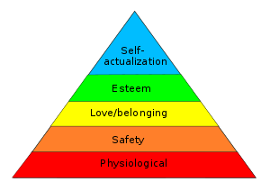
Maslow's hierarchy of needs is a theory in psychology proposed by Abraham Maslow in his 1943 paper "A Theory of Human Motivation" in Psychological Review. Maslow's hierarchy of needs, represented as a pyramid with the more basic needs at the bottom. A person who meets his or her needs to the highest level possible for his or her lifespace is, according to Maslow, a self-actualized person. A fully self-actualized person is one who possesses a balanced and integrated personality, with such positive traits as autonomy, creativeness, independence, and a healthy goal directedness.

Slide 14
“Teaching,” claims Rogers, “is a vastly over-rated function.” He bases this view of teaching on the importance of what he calls “experiential learning.”
Experiential learning (Self-initiated):
is filled with personal involvement; the whole person is in the learning event rather than being a passive absorber of whatever the teacher teaches.
It is pervasive.
It influences every aspect of learner’s being.
It is evaluated by the learner not by the teacher or tests.
It says that learning has personal meaning for learners.
It can not be controlled by a teacher.
It must be freely engaged in by the learner
the teacher can only guide, suggest, encourage, and maybe warn.

Slide 15
In short, Humanistic Psychology, as Maslow and Rogers make quite evident, is a psychology based on freedom, choice, personal growth, and the development of emotional and mental health. In their view, education makes a significant contribution to these ends, but not by the traditional mechanisms of packaging subject-matter content for delivery to student learners. Instead, the student must be helped to attain his or her own actualization.

Slide 16
Normativity and Normative Considerations:
The normative domain is typically defined as the domain of what ought to be or what ought to be done, and contrasted with the descriptive domain, i.e. the domain of what is. This characterisation should perhaps not be taken too literally.
Normative considerations have to do with what should or ought to be the case, rather than with what is believed to be the case (descriptive considerations). Normative considerations often point to ideals and aims, to what we believe is best and right in the human species.

Slide 17
Normativity is what brings ends, the E in MAKER, to the fore. When E is prominent in an approach, it signifies that the approach is rooted in certain ideals and aims, that the approach contains normative considerations. E plays a dominant role in the facilitator and liberationist approaches, but not in the executive approach.
Recall that in the executive approach, M and K are dominant elements. E does not occupy a position of importance, because, for the executive, E is so closely associated with K. That is, what the executive seeks is to have the students acquire the knowledge that is being taught, in the belief that possession of this knowledge is essential to such goals as a productive workforce, good citizenship, national security, and global competitiveness.
The executive typically holds goals for schooling that are broadly societal and economic, and thus instrumental in character. In contrast, the normative ends sought by the facilitator and liberationist are pursued directly with each student and grounded in a conception of what makes the student the best possible person.

Slide 18
Existential Roots: To the teacher as facilitator, the student’s authenticity is not cultivated by acquiring remote knowledge that is unrelated to the quest for personal meaning and identity. Filling students’ heads with knowledge that has been selected, packaged, and conveyed by others only keeps students from grasping themselves as human beings. The basic ideas that sustain so much of the normative stance in facilitative teaching can be found in a school of philosophy known as existentialism. One of the few tenets that existentialists such as Camus, Kirkegaard, and Dostoyevsky hold in common is that existence precedes essence, that we simply are before we are anything in particular.

Slide 19
The normativity that is characteristic of the facilitator approach helps us gain a better sense of how the A and the E of MAKER are interconnected. In order to achieve the ends called for, such as self-actualization, authenticity, and personal meaning, the teacher must have an awareness of her students. This awareness takes the form of insight into the life experiences of students as well as the knowledge and understanding that students bring with them as they pass through the schoolhouse door. To forge the critical links between A and E, the teacher has to attend to the quality of the relationship (R) with students. The R element assumes a quite special status in a modern version of facilitation known as care pedagogy.

Slide 20
Care Pedagogy: “We sometimes speak as if caring did not require knowledge, as if caring for someone, for example, were simply a matter of good intentions or warm regard. But in order to care I must understand the other’s needs and I must be able to respond properly to them, and clearly good intentions do not guarantee this. To care for someone, I must know many things.”—Milton Mayeroff The pedagogy of care is a science. Now more than ever, we possess the brain research that demonstrates what we’ve always known instinctively: children are learning from the moment they are born and the most meaningful lessons are embedded in care. Care requires personal knowledge of people. Care requires sharing. Care requires sharing and empathy with others different from ourselves.

Slide 21
According to care theory, justice is an inadequate standard for human conduct. Justice, argue the care theorists, has permitted the moral rationale for such things as the egregious treatment of prisoners, acts of war, the slaughter of noncombatants, and indifference to poverty and disability.
Given the humanistic psychologists’ low estimation of the value of teaching for learning, they gave little attention to the nature and quality of the relationship between teacher and student. The humanists appear to view the teacher more as a remover of barriers and impediments to choice, as a creator of environments of opportunity and possibility for the learner, than as one who forges profound relationships with students.

Slide 22
Care pedagogy represents a fascinating evolution in humanistic education. While it is highly responsive to the social critiques of the 1960s and shares elements of humanistic psychology and existentialism, it stands quite independent of its precursors. It recasts the A so critical to the humanistic educators, into an R, such that A does not stand alone but as part of the R that obtains between the one caring and the cared for, between the teacher and the learner. Care pedagogy brings the teacher back into a much more crucial role in the growth of the learner than was the case in humanistic education.

Slide 23

Facilitating Identity

Slide 24

It is the role of schooling in promoting an understanding of and respect for certain human differences.
Nowadays every one knows how very contentious these topics are; because of this, it is a challenge to present them in a way that clearly demonstrates their educational importance.
The facilitator approach opens a path for doing so.

Slide 25
:Most often identified as multiculturalism or diversity, it is the role of schooling in promoting an understanding of and respect for certain human differences.
RACE
Most prominent examples of these differences
ETHNICITY
GENDER
DISABILITY
SEXUAL ORIENTATION

Slide 26
1.Who am I? 2.To what do I belong? 3.What are my roots? 4.How am I recognized by others? 5.What is it that I am becoming?
When the facilitator claims that among his ends are authenticity, growth, and self-actualization, he is saying that it is essential to address certain questions:
These are questions of identity.

Slide 27

The facilitator believes that these identify questions are vital to educative process.

Slide 28

What is that goes into the formation of our identities???
An enormously powerful influence on identity formation is applied when a person comes to understand that he or she is different from some norm or standard.

Slide 29
Q:What is it that goes into the formation of our identities??
The answer is: it depends!
It depends on where and to whom we are born; on where we are reared; on friends, neighborhoods, and associations that make up our life experiences; on the stories we are told and the songs we learn to sing; and on how we are recognized and treated by others.

Slide 30

The person begins to grasp not only that he or she is different, but that he or she also is less valued because of this difference.

Slide 31

Among the ways of coping with the recognition that one is different and less valued is to unite with others who share this difference.
The intent of such programs is to aid in the formation of a strong, positive identity.
This objective is highly consistent with the ends supported by the facilitator.
The interest in multiculturalism and diversity is not the sole province of the facilitative teacher. The liberationist approach is also concerned with how differences in such things as race, culture and gender are dealt with in the context of school.

Slide 32

What distinguishes the facilitator from the liberationist is:
The facilitator focuses on the person, in the form of both awareness (A) and relationship (R)
But
The liberationist depends more on ends (E) and knowledge (K) in the formation of identity.
For the facilitator, the pursuit of diversity is much about doing what is best to aid in the formation of people with these characteristics:
Fully capable
Fully functioning
Self-aware
Able to make thoughtful choices

Slide 33

A facilitative teacher not only aknowledges important differences between his or her students, but also notices curefully to the various ways students recognize one another.
Such teacher’s relationships to their students are deeply embedded in knowing the students and caring for them; they establish clear expectations for classroom interactions.
They find and praise what is worthy in the important differences that characterize students.

Slide 34
This approach is about doing what is best to aid in the formation of a fully capable, fully functioning person, one who is self-aware and able to make thoughtful choices.
Facilitator teachers’ relationships to their students are deeply embedded in knowing the students and caring for them
They find and publicly praise what is special and worthy in the
important differences that characterize students.
so

Slide 35
Constructivism

Slide 36

Constructivism & multiple intelligences are two quite different notions about how we learn, but both are derived from the same school of psychology known as “cognitive psychology”.

Slide 37
Constructivism
Cognitive Psychology
Multiple intelligences
Both notions attend to how the mind processes experience, particularly how mental organization, memory, and learning are accomplished. we can draw some inferences about how to organize instruction.
These inferences permit us to acquire information in ways that are most closely aligned with how the mind processes information

Slide 38
What is constructivism?
Constructivism is ‘an approach to learning that holds that people actively construct or make their own knowledge and that reality is determined by the experiences of the learner’ (Elliott et al., 2000:256).
In elaborating constructivists’ ideas Arends (1998) states that constructivism believes in personal construction of meaning by the learner through experience, and that meaning is influenced by the interaction of prior knowledge and new events.

Slide 39

Constructivism says that children learn by constructing meaning for what they experience.
It means that learners do not simply accept which is presented to them. Instead, they try to make sense of it, often by connecting it to other information already present.
This process might alter the learner’s mental frameworks or might cause the student to change the new information to fit the framework already in place.
Jean Piaget referred to these processes as assimilation and accommodation.

Slide 40
What is the role of student?
Constructivism contends that children learn by constructing meaning for what they experience. They try to make sense of it, often by connecting it to other information or mental organizations already present.
What is the role of teacher?
The constructivist teacher attempts to assist students to acquire concepts and mental structures that accommodate subject matter in ways that are both valid and meaningful

Slide 41

The constructivist encourages students to use whatever experience, knowledge and mental frameworks they bring to school, while guiding them in the formulation of newer and more powerful concepts in order to assimilate and accommodate the subject matter of study.

Slide 42

The positive side of constructivism is that it attends carefully to the connections between the mental “maps” the students have when they enter the classroom and the knowledge the teacher seeks to present once they are there.
The downside of constructivism is that students may believe that they correctly understand new material when in fact they do not, and the teacher may conclude that their understanding is correct when it is not!

Slide 43

New information and experience must be presented in ways that facilitate the learner’s imparting meaning to it, generally by connecting it to understandings already held and building new frameworks to accommodate it.

Slide 44
Multiple Intelligences

Slide 45
Multiple Intelligences
Gardner argues that human beings have the ability to solve many different kinds of problems and make or create things that are valued in one or more cultural settings.
1.Linguistic intelligence (as possessed by a poet, for example
2.Logical-mathematical intelligence (as in a physicist or mathematician)
3.Spatial intelligence (sculptor or architect)
4.Musical intelligence (cellist or conductor)
5.Bodily-kinesthetic intelligence (dancer, athlete)
6.Interpersonal intelligence (sensitivity to others; for example, a teacher)
7.Intrapersonal intelligence (possessing a well-developed sense of self)

Slide 46

Intelligences | Examples or features
1.Linguistic | poet
2.Logical-mathematical | physicist, mathematician
3.Spatial | sculptor, architect
4.Musical | cellist, conductor
5.Bodily-kinesthetic | dancer, athlete
6.Interpersonal | teacher
7.Intrapersonal | well-developed sense of self
Howard Gardner in
his
1983 work argued for seven intellig-ences:

Slide 47
In a later work, Gardner suggests two additional forms: naturalist intelligence, which is the ability to recognize and categorize objects in nature; and existential intelligence, which is a capacity to grapple with the profound questions of human existence.
The idea that there are other intelligences worthy of cultivation in the setting of the school offers the teacher a strong rationale for supporting a broad range of choices as students pursue their interests and talents.

Slide 48

In
later work, Gardner suggests two additional forms:
1.Naturalist intelligence | The ability to recognize & categorize objects in nature
2.Existential intelligence | A capacity to grapple with the profound questions of human existence

Slide 49
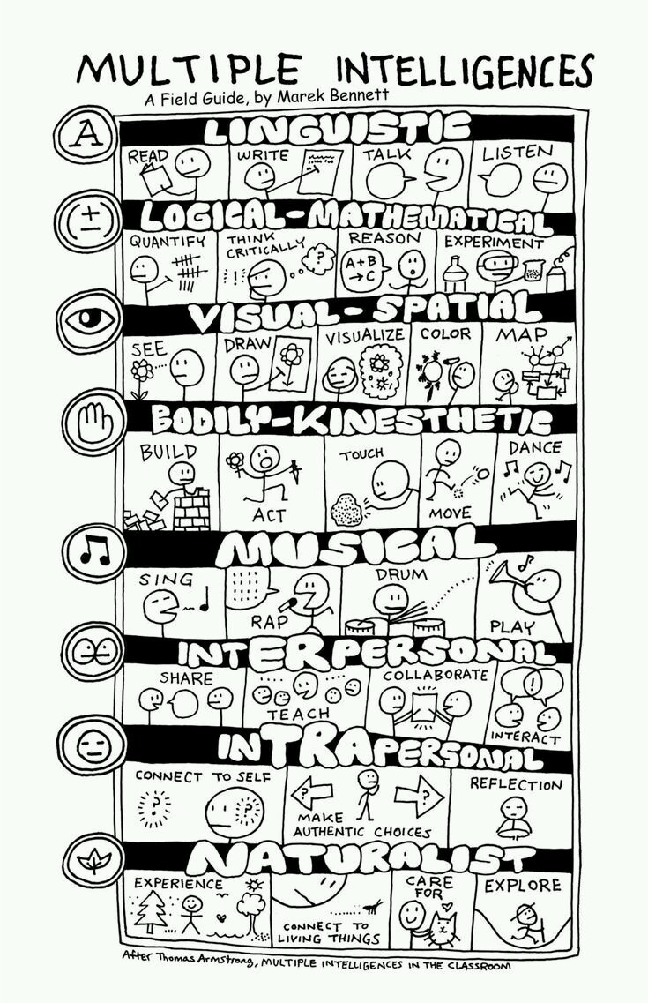


Slide 50
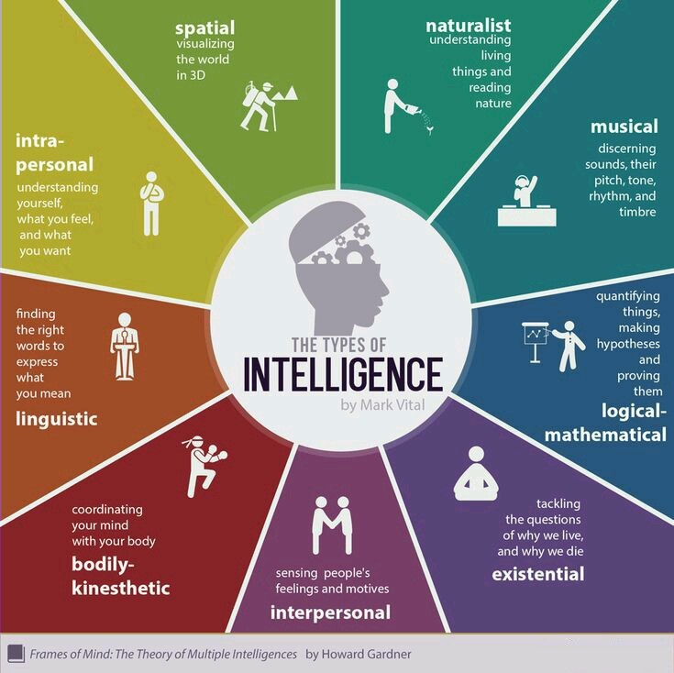

Slide 51

“If you go back to the (A) in maker, you will note that Gardner’s theory offers a facinating way to become more aware of one’s students.”

Slide 52

Another aspect of MI theory is that it supplies the facilitative teacher with educationally relevant reasons for respecting the choices that students make.
“Choice is a key feature of the facilitative setting.”

Slide 53

MI theory does not support ignoring the development of one or more intelligences while pursuing the development of some others.
Gardner insists that the intelligences often work jointly.
Consider dance as an example; how many intelligences might be involved in a performance?
Spatial
Musical
Bodily-kinesthetic
….

Slide 54

Accomplishments & achivements on the students’ part generally call for the use of several different intelligences.

Slide 55

Constustivism and MI theory both have their own critics, however, it is clear that:
Both are easily situated within the facilitator approach.
Both represent the student as an active agent in his or her own learning.
Both expand the teacher’s capacity for becoming aware of her students as well as for honoring their choices.

Slide 56


